Slide 1
Imbalanced
Classification
Seminar Presentation on ‘Image Processing for Document Automation (WS23/24)’
Guidance:
Dr. Tobias Alt-Veit
Dr. Darko Obradovic
By: Ritik Gupta & Prajna Shetty

Slide 2
Table Of Content
A systematic study of the class imbalance problem in convolutional neural network
Introduction
Experimental Setup
Forms of imbalances
Methods of addressing imbalance
DataSets & Models
Results
Focal Loss for Dense Object Detection
Introduction
Focal Loss: Motivation
Retina Net
Results

Slide 3
“A systematic study of the class imbalance problem in convolutional neural network”
-Buda, M., Maki, A., & Mazurowski, M. A.

Slide 4
Introduction
“A systematic study of the class imbalance problem in convolutional neural network”
Insight on Impact of class imbalance on convolutional neural networks (CNNs) classification performance and compare frequently used methods to address the issue. ​
Three benchmark datasets used in this experiment: ​
MNIST - (Modified National Institute of Standards and Technology)
CIFAR-10 - (Canadian Institute for Advanced Research)
ILSVRC-2012 (ImageNet) - (ImageNet Large Scale Visual Recognition Challenge)
Evaluation metric: Area under the receiver operating characteristic curve (ROC AUC) adjusted to multi-class tasks.​
Notes:
A common problem in ML and Deep learning algos is some classes having much higher/lower no of samples in training set resulting in biased output in the model.

Slide 5
​Methods for addressing class imbalance:​
Data level methods: Operates on training set and change its class distribution.​
Oversampling: Ex: SMOTE.​
Undersampling. Ex: One-sided selection.​
Classifier level methods: Algorithmic level adjustments.​
​Thresholding.
Cost sensitive learning.​
Hybrid of methods.

Slide 6
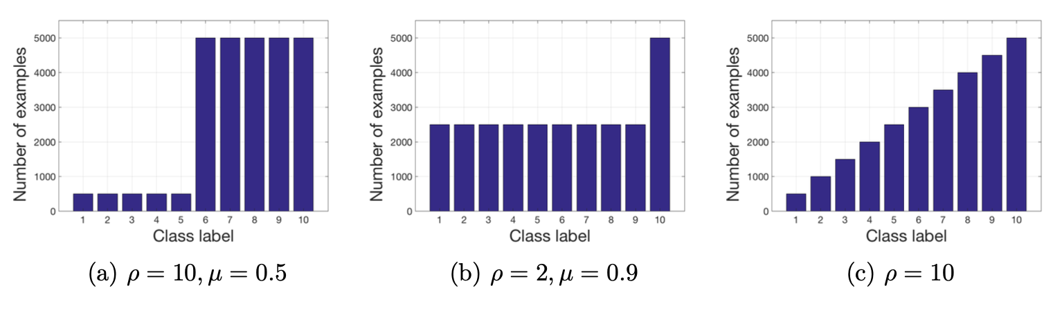
Experimental Setup
Forms of imbalances: Step Imbalance and Linear Imbalance
Where, μ = the fraction of minority classes.
ρ = ratio of samples in majority classes by samples in minority classes.
Figure1: Step Imbalance(a-b) & Linear Imbalance(c) (Buda et al., 2018)
Notes:
In some problems only one class might be underrepresented or overrepresented and in other every class will have a different number of examples.

Slide 7
2. Methods of addressing imbalance:
Random minority oversampling​.
Random majority undersampling​.
Two-phase training with pre-training on randomly oversampled dataset .
Two-phase training with pre-training on randomly undersampled dataset.
Baseline (do-nothing) .
Notes:
Pre-training is done on a modified dataset and fine-tuning on Original.

Slide 8
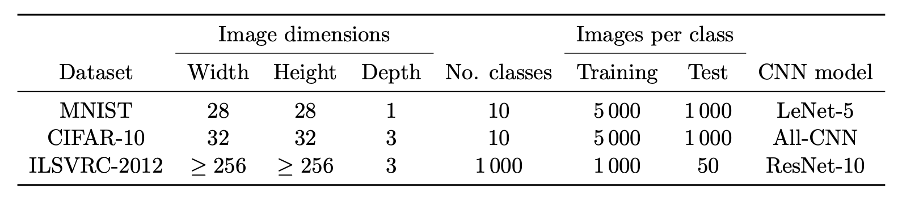
3. DataSets & Models:
Introduces artificial imbalance for MINST and CIFAR-10 datasets and is trained using stochastic gradient descent (SGD).
Table1: Summary of used Datasets (Buda et al., 2018)
Notes:
All models for the same dataset were run an equal number of training iterations, ensuring a consistent comparison.

Slide 9
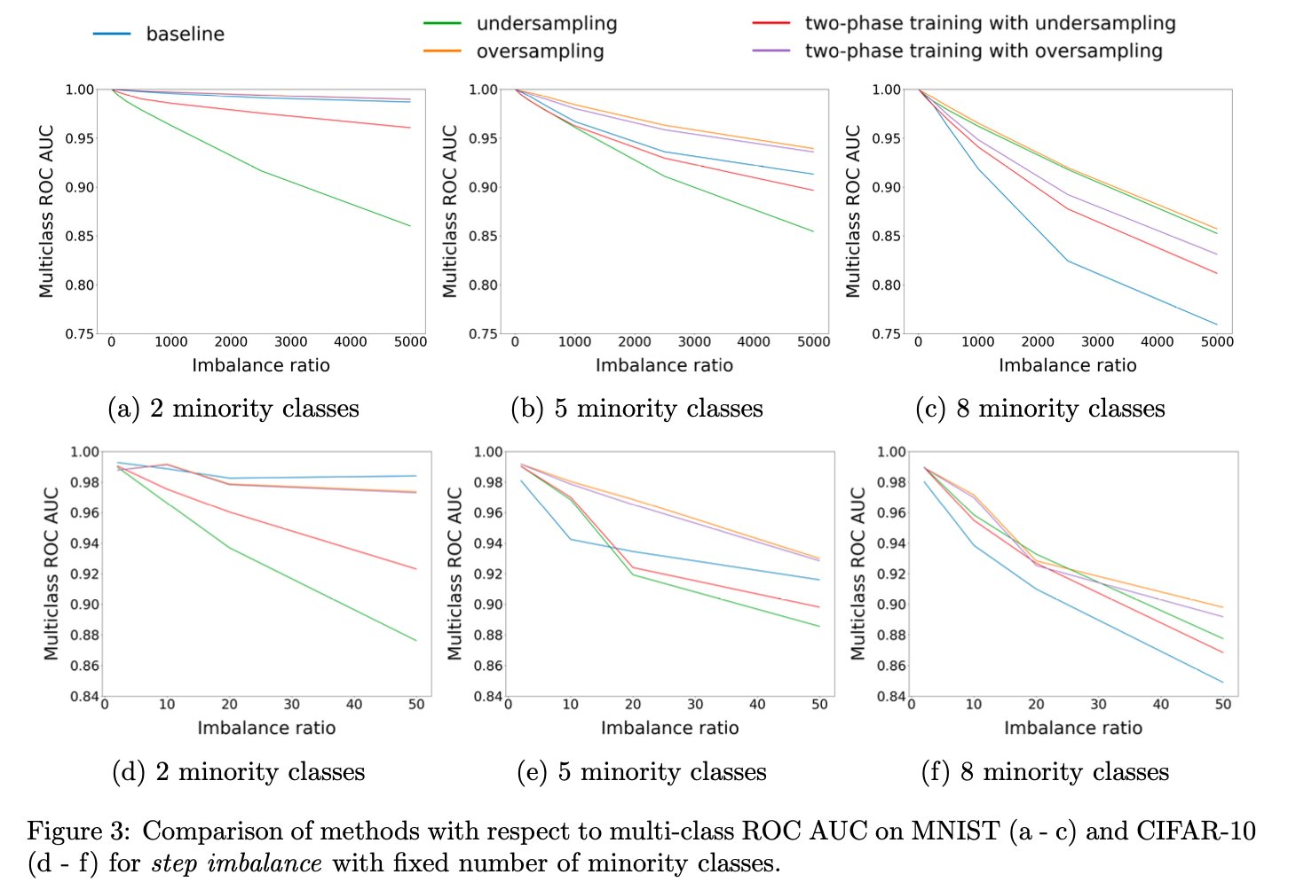
Results
Step Imbalance:
The effect of class imbalance on classification performance is detrimental.
Imbalance is significantly stronger for tasks with higher complexity.
The increasing no of minority classes as well as Imbalance ratio had a negative effect on performance.
Figure 2: Comparison on MNIST (a - c) and CIFAR-10 (d - f) for step imbalance with fixed minority classes. (Buda et al., 2018)
Notes:
We notice that oversampling method uses the same amount of data as the baseline. It only eliminates the imbalance which should improved the performance in almost all the cases. Still, it does not reach the performance of a classifier trained on the original dataset.

Slide 10
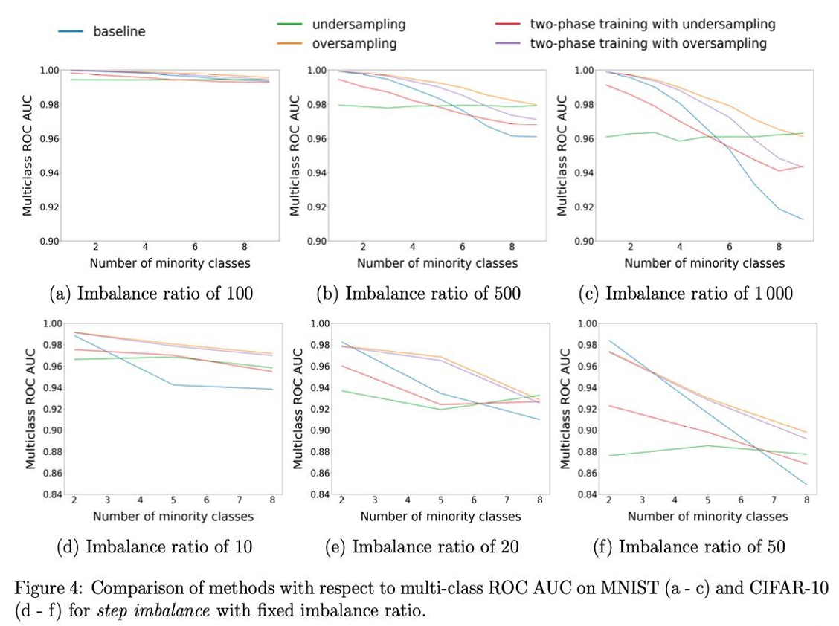
Results
Two-phase training methods perform between the baseline and their corresponding methods.
For extreme cases, undersampling performs better than baseline and on a par with oversampling.
Figure 3: Comparison on MNIST (a - c) and CIFAR-10 (d - f) for step imbalance with fixed Imbalance ratio. (Buda et al., 2018)
Notes:
If the baseline is better than one of these methods, fine-tuning improves the original method
It means that, between two sampling methods that eliminate imbalance, even using fewer data can be comparable.
If training time is an issue, undersampling is a better choice in such a scenario since it dramatically reduces the size of the training set.

Slide 11
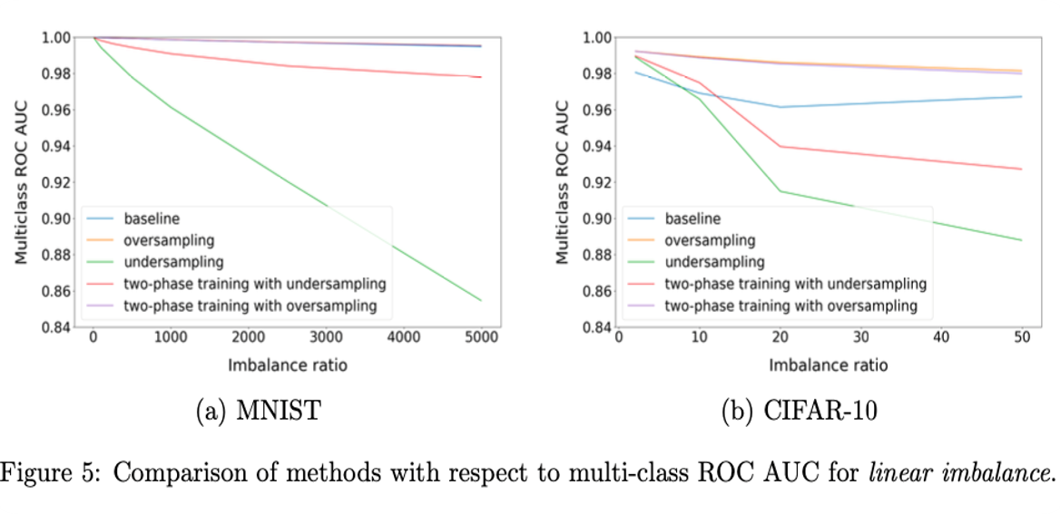
Results
Linear Imbalance:
Score for undersampling decreases approximately linearly with imbalance ratio.
The drop in performance is much higher for step imbalance compared to Linear imbalance.​
Oversampling does not cause overfitting of CNNs, as opposed to some classical machine learning models.
Figure 4: Comparison of methods w.r.t multi-class ROC AUC on MNIST and CIFAR-10 for linear imbalance. (Buda et al., 2018)
Notes:
Not only the total number of examples, but also its distribution between classes matters.

Slide 12
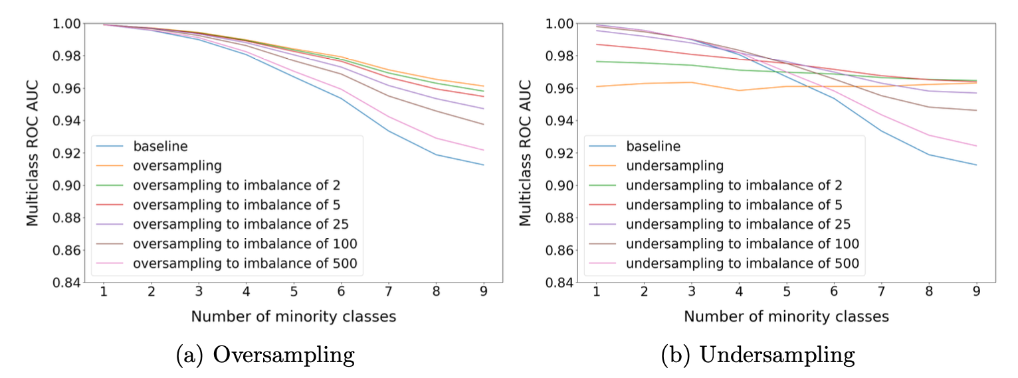
Results
There is a level to which we can apply undersampling and achieve equivalent performance as oversampling.
Oversampling should be applied to the level that completely eliminates the imbalance, whereas the optimal undersampling ratio depends on the extent of imbalance.
Figure 5: Comparison of oversampling and undersampling to reduced imbalance ratios on MNIST (Buda et al., 2018)
Notes:
However, that level is not known a priori rendering oversampling still the method of choice.

Slide 13
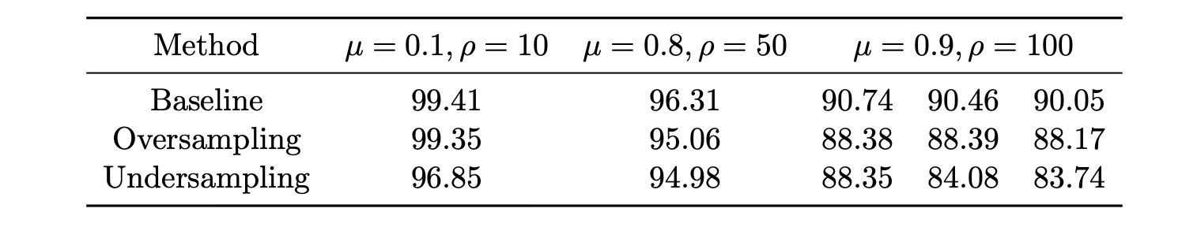
Results
For ImageNet, Small decrease in performance for oversampling for extreme imbalances.
Oversampling consistently emerged as the most effective method in almost all situations.​
Table2: Comparison of results on ImageNet w.r.t multi-class ROC AUC. (Buda et al., 2018)c

Slide 14
“Focal Loss for Dense Object Detection”
-Lin, Tsung-Yi

Slide 15
Introduction
“Focal Loss for Dense Object Detection”
The document presents a novel loss function, the Focal Loss and outlines the challenges faced by one-stage detectors.
Aim to address the class imbalance issue encountered during the training of one-stage detector.

Slide 16
Two-stage Detectors
Approach:
Utilizes a two-stage methodology for object detection.
First stage: Generates sparse candidate proposals containing objects and filters out negative locations.
Second stage: Classifies proposals into foreground or background classes.
Pioneers and Frameworks:
Originated with Selective Search and further developed in frameworks like R-CNN, Faster R-CNN, and their variants.
Performance:
Consistently achieves top accuracy on challenging benchmarks such as COCO.

Slide 17
One-stage Detectors
Approach:
Applies detection over regular, dense sampling of object locations, scales, and aspect ratios.
These detectors are designed to be faster and simpler,
Examples:
OverFeat, SSD, and YOLO are prominent examples of one-stage detectors.
Advantages and Challenges:
Potential for speed and simplicity compared to two-stage detectors.
Historically trailed in accuracy.
Faces challenges related to class imbalance during training due to processing a larger set of candidate object locations.

Slide 18
Standard Cross-Entropy Loss
In standard cross-entropy loss, each training example contributes equally to the overall loss regardless of its difficulty.
Misclassified examples (where the predicted probability for the true class is low) contribute significantly to the loss, driving the model to correct these errors.
Well-classified examples (where the predicted probability for the true class is high) also contribute to the loss, but their impact may not be as significant.

Slide 19
Focal Loss: Motivation
Focal Loss is a novel loss function designed for dense object detectors, addressing extreme class imbalances encountered during training, particularly in one-stage detectors.
Reshapes standard cross-entropy loss to mitigate the impact of class imbalance.
Down-weights loss for well-classified examples and focuses training on hard examples.
Introduces a modulating factor, (1 - pt)^γ, to the cross-entropy loss.
The focusing parameter γ controls the strength of the modulating term
FL(pt) = −(1 − pt)^γ log(pt).
Notes:
Focal Loss introduces a parameter γ, which allows for the modulation of loss contribution based on the confidence of the prediction.
When γ is greater than 0, it reduces the relative loss for well-classified examples (where the predicted probability is high, typically above 0.5).
This reduction in loss for well-classified examples effectively down-weights their contribution to the overall loss function.
Consequently, the model focuses more on hard, misclassified examples during training.

Slide 20
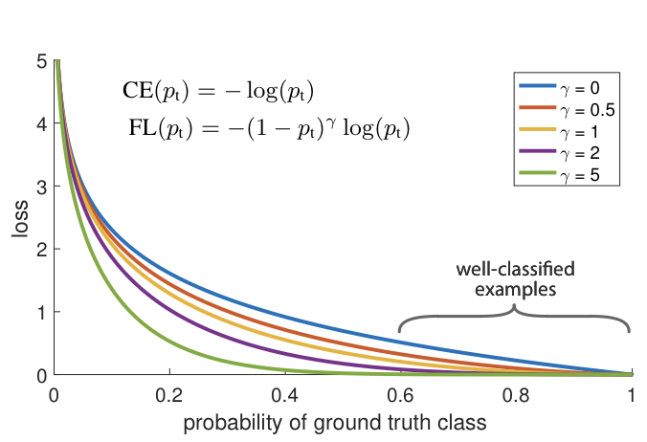
Focal Loss: Motivation
Automatically down-weights the contribution of easy examples during training.
Rapidly focuses the model on hard examples, improving its ability to learn from challenging instances.
Figure 6: (Lin, Tsung-Yi 2017)
Notes:
We propose a novel loss we term the Focal Loss that
adds a factor (1 − pt)γ to the standard cross entropy criterion.
Setting γ > 0 reduces the relative loss for well-classified examples
(pt > .5), putting more focus on hard, misclassified examples. As
our experiments will demonstrate, the proposed focal loss enables
training highly accurate dense object detectors in the presence of
vast numbers of easy background examples

Slide 21
Focal Loss VS Cross-Entropy
Let’s say
the foreground is classified with predicted probability p=0.05
background object misclassified with predicted probability p=0.95.
pt = {0.95, when Yact=1 1-0.05 ,when Yact = 0}
CE(FG)= -ln (0.05) = 2.995732273553991
CE(BG)= -ln (1-0.95) = 2.995732273553992
Let’s consider the same scenario Focal loss with ∝ = 0.25 & γ =2.
FL(FG)= -0.25 * (1-0.05)2 *ln (0.05) = 0.675912094220619
FL(BG)= -0.75 * (1-(1-0.95))2 *ln (1-0.95) =2.027736282661858
Notes:
scenario-2: 2.3/0.667 = 4.5 times smaller number

Slide 22
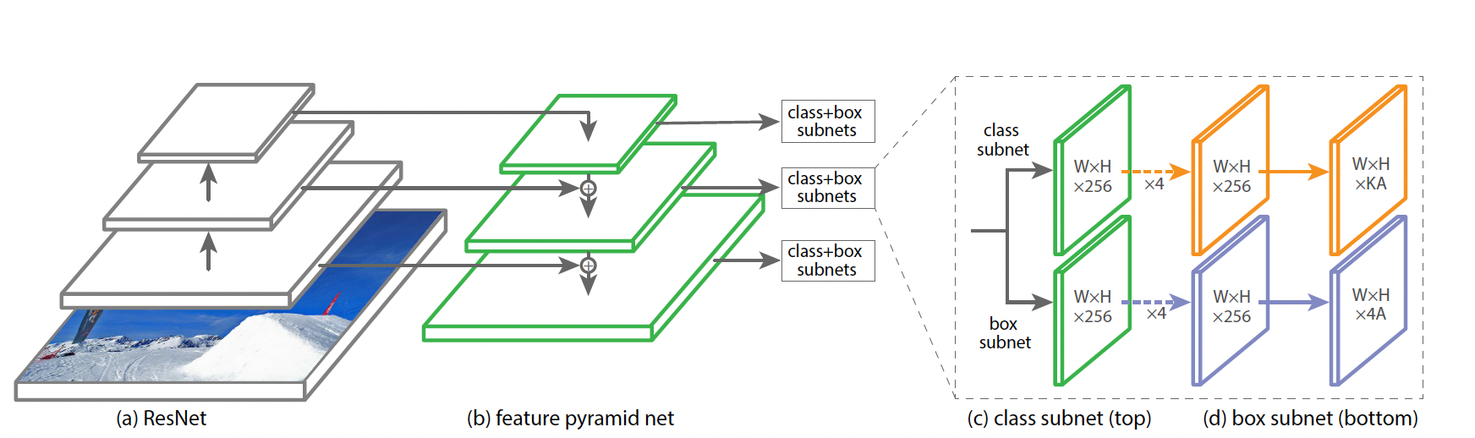
ReTina Net
Figure 7: Architecture of RetinaNet (Lin, Tsung-Yi 2017)

Slide 23
ReTina Net
RetinaNet is a single, unified network designed for dense object detection, composed of a backbone network and two task-specific subnetworks
The backbone network is responsible for computing a convolutional feature map over an entire input image and is based on the Feature Pyramid Network (FPN) architecture.
The RetinaNet detector attaches two subnetworks to the FPN backbone: the classification subnet and the box regression subnet.
The classification subnet predicts the probability of object presence at each spatial position for each anchor and object class.

Slide 24
ReTina Net
The box regression subnet, operating in parallel with the classification subnet, regresses the offset from each anchor box to a nearby ground-truth object, if one exists.
The RetinaNet architecture is intentionally simple, focusing on a novel focal loss function that eliminates the accuracy gap between one-stage detectors and state-of-the-art two-stage detectors,
RetinaNet is a highly effective and efficient one-stage object detector
Its design and the use of the novel focal loss function contribute to its success in surpassing previous detection models.

Slide 25
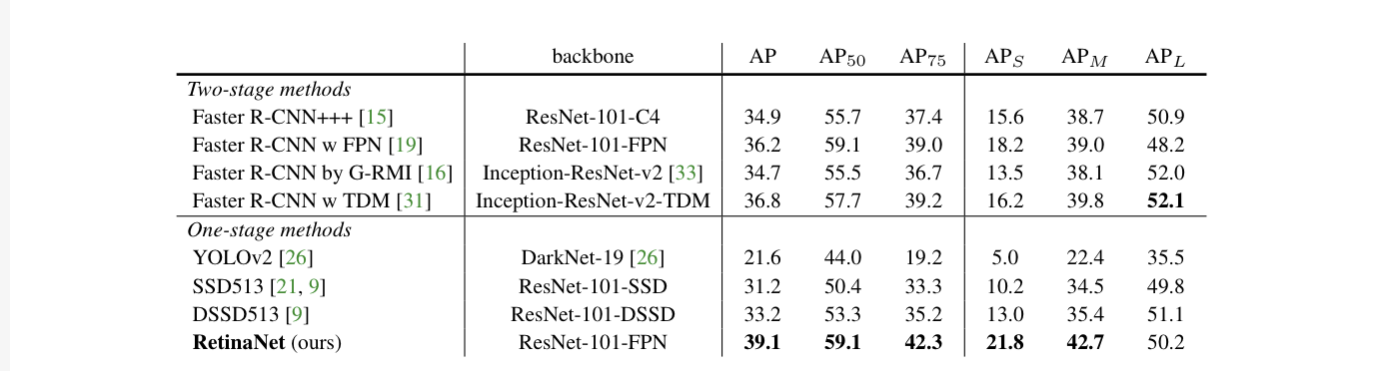
Results
Table 3: Results on RetinaNet (Lin, Tsung-Yi 2017)

Slide 26
References
Buda, M., Maki, A., & Mazurowski, M. A. (2018). A systematic study of the class imbalance problem in convolutional neural networks. Neural Networks, 106, 249–259.
Lin, Tsung-Yi, et al. "Focal loss for dense object detection." Proceedings of the IEEE international conference on computer vision. 2017

Slide 27
Thank You

